Slide 1



C
I
E
R
M
CRIME ANALYSIS AGAINST WOMEN USING CLUSTERING & CLASSIFICATION
PRAGADEESHWARAN O

Slide 2


ABSTRACT
This study investigates the most effective machine learning methods for recognizing and predicting crime patterns. The implementation of Recursive Feature Elimination (RFE) for feature extraction removes many repetitive features, which speeds up processing time. Model tuning is further accelerated through automated hyperparameter tuning with BayesSearchCV. Effective preprocessing guarantees scalability, making it possible to work with big data. The use of Python, Scikit-Learn, and Pandas allows for a more cost-efficient approach. K-Means and DBSCAN cluster different types and geographies of crime into crime types and regions based on patterns. Predictive models such as Random Forest and SVM are used to attain high levels of accuracy in prediction. The system drives and provides insights with intent, which allows decision makers to take action on high impact areas. Data led decisions facilitate the creation of advanced crime prevention strategies. This study assists in automatic crime evaluation and police support system which is aimed for smart crime and police management.

Slide 3

OBJECTIVE
This project aims to analyze crimes against women in India (2001-2021) using clustering and classification techniques to:
Identify Patterns: Discover hidden trends in crime data using unsupervised learning.
Classify New Cases: Use supervised learning models to predict crime categories.
Enhance Decision-Making: Provide actionable insights for law enforcement and policymakers.
Improve Crime Prevention: Identify high-risk areas and crime types to aid in preventive measures.

Slide 4
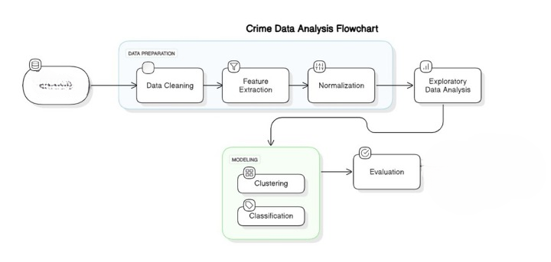
ARCHITECTURE DIAGRAM:
Data preparation

Slide 5
METHODOLOGY
Data Processing
Cleaning: Handled missing values, standardized definitions.
Feature Engineering: Created new features, encoded categorical data.
Normalization: StandardScaler/MinMaxScaler for consistency.
Exploratory Data Analysis (EDA)
Trends & Patterns: Crime trends, geographic distribution.
Visualizations: Correlation heatmaps, crime hotspots.
Modeling
Clustering: K-Means, DBSCAN (Silhouette Score, PCA visualization).
Classification: Random Forest, Decision Trees, SVM, etc. (Tuned with BayesSearchCV).
Feature Selection: Recursive Feature Elimination (RFE).
Evaluation & Insights
Clustering: Identified high-risk regions and crime trends.
Classification: Achieved high accuracy, KNN performed best.
Outcome: Improved crime trend prediction & policy recommendations.

Slide 6
LITERATURE REVIEW
S No | Title & Author | Year & Journal | Methods / Methodology | Key Findings | Future Work
1 | Severity and Distributional Analysis of Crime against Women in India Dr. N Chandrasekaran, Prof. C R Rajan | 2015, IJHSSE | NCRB data analyzed using CAGR and percentage contribution. | Kidnapping and abduction crimes growing fast. Delhi, Assam have highest crime rates per lakh women. | Faster judicial processes, increased female police participation, public awareness campaigns.
2 | Behavioural Analysis of Crime against Women using a Graph-Based Clustering Approach Priyanka Das and Asit Kumar Das | 2017, ICCCI-2017 | Evaluates Infomap clustering algorithm on crime data (2001-2014) to detect crime trends in Indian states and UTs. | Infomap clustering effectively detects crime trends and hotspots. | Extending analysis for global crime trends and detailed state-wise analysis.
3 | Determinants of Crimes Against Women in Pre and Post Liberalized India Jasneek Arora and Shalini Singh Sharma | 2017, Int. J. of Economic Research | NCRB, NSSO, CSO data (1991-2015) analyzed to find crime determinants. | Literacy rate significantly impacts crime. Urbanization shows no strong correlation. | Further research on cultural and socio-economic factors affecting violence against women.

Slide 7
S No | Title & Author | Year & Journal | Methods / Methodology | Key Findings | Future Work
4 | Diagnosis of Crime Rate against Women using k-Fold Cross Validation through ML Algorithms P. Tamilarasi and Dr. R. Uma Rani | 2020, ICCMC | ML models (KNN, Decision Trees, Naïve Bayes, Linear Regression, CART, SVM) tested on crime data (2001-2012) using k-fold cross- | KNN achieved the highest accuracy in crime rate prediction. | Exploring alternative cross-validation methods and more recent datasets.
5 | EIC’s Summary on VAW Geetha Balsarkar | 2021, J. of Obstetrics & Gynecology of India | Review of four studies on violence against women, including adolescent depression and COVID-19 impact. | Highlights severity, impact on adolescent girls, and increased domestic violence during COVID-19. | Calls for inclusive policies, improved research methodologies, and region-specific interventions.
6 | Crime against Women in India: A State-Level Analysis Chandrima Chakraborty, Anam Afreen, Dipyaman Pal | 2021, J. of International Women’s Studies | Panel regression analysis of NCRB data (2001-2015). | Economic growth initially increases crime, then reduces it after a threshold. | Further analysis of individual crime types for better insights.

Slide 8
S No | Title & Author | Year & Journal | Methods / Methodology | Key Findings | Future Work
7 | Crime Forecasting: ML & Computer Vision for Prediction & Prevention Neil Shah, Nandish Bhagat, Manan Shah | 2021, Visual Computing for Industry, Biomedicine & Art | Review of ML and computer vision in crime prediction. | ML & computer vision significantly improve crime detection and prevention. | Research on real-time ML models for higher accuracy.
8 | Does Development Deter Crime Against Women? Panel Evidence from India Suhasini Gupta, Pradeep Kumar Sahoo, Kirtti Ranjan Paltasingh | 2022, J. of Business & Socio-economic Development | Panel regression model on 28 states' data (2000-2019). | Higher HDI and female labor force participation reduce crimes against women. | Region-specific interventions and further study on socio-cultural norms.
9 | Crime Prediction and Analysis R. Karthik Sriraam, S.M. Keerthivasan, K. Sukant, A. Krishnamoorthy | 2022, J. of Pharmaceutical Negative Results | Decision Tree, Gaussian Naïve Bayes, K-means clustering on Chennai crime data with 10-fold cross-validation. | Decision Tree Classifier had highest accuracy (83.6%). K-means was effective in clustering. | Enhancing models with more algorithms and socio-economic factors.

Slide 9
S No | Title & Author | Year & Journal | Methods / Methodology | Key Findings | Future Work
10 | Patterning of Sexual Violence across US Cities and Counties Jennifer Pabst, Scott M. Walfield, Ryan Schacht | 2022, Social Sciences | Generalized linear mixed models using US Census and crime data. | Sex ratio imbalance influences sexual violence. Balanced sex ratios have lowest violence rates. | Studying specific violent behaviors beyond simplistic male-female ratio predictions.
11 | Crime Prediction Using Machine Learning: A Comparative Analysis by Abdulrahman Alsubayhin, Muhammad Ramzan, and Bander Alzahrani | 2023, Journal of Computer Science | Comparative analysis of 51 research studies on crime prediction using machine learning methods such as KNN, decision trees, Naïve Bayes, random forest, etc. | The supervised learning approach is the most commonly used. Random forest was the most commonly used method and produced accurate results in most studies. | Evaluate ML-based algorithms in real-world situations to identify factors affecting accuracy and improve techniques for better accuracy. |
12 | Crime Prediction Using Machine Learning: A Comparative Analysis by Abdulrahman Alsubayhin, Muhammad Ramzan, and Bander Alzahrani | 2023, Journal of Computer Science | Comparative analysis of 51 research studies on crime prediction using machine learning methods such as KNN, decision trees, Naïve Bayes, random forest, etc. | The supervised learning approach is the most commonly used. Random forest was the most commonly used method and produced accurate results in most studies. | Evaluate ML-based algorithms in real-world situations to identify factors affecting accuracy and improve techniques for better accuracy. |

Slide 10
S No | Title & Author | Year & Journal | Methods / Methodology | Key Findings | Future Work
13 | Under-Reporting in Violence Against Women Analysis in Italy Silvia Polettini, Serena Arima, Sara Martino | 2024, Social Indicators Research | Bayesian hierarchical model analyzing under-reporting in Italy (2019-2020). | Socio-economic factors significantly affect violence rates and reporting. | Expanding data sources for broader analysis.
14 | Role of AI in Crime Prediction and Pattern Analysis Manpreet Kaur, Munish Saini | 2024, AI Review | Scientometric analysis of CPPA research using Scopus data. | Identified five AI method clusters. USA, India, China are key contributors. | Further studies on AI advancements in CPPA.
15 | Crime against Women in India: District-Level Risk Estimation using Small Area Estimation Pooja BS, Vasudeva Guddattu, K. Aruna Rao | 2024, Frontiers in Public Health | Small Area Estimation, hotspot analysis, spatial regression on NCRB crime data (2020-2022). | Crime rates increased from 2020-2022. High-risk states identified. | Socio-cultural interventions and individual-level studies in priority areas.

Slide 11
RESEARCH GAP
Lack of Comprehensive Analysis:
Existing studies often focus on individual states or specific crimes against women rather than a comprehensive national analysis.
Spatial and Temporal Distribution:
There's insufficient research on the spatial and temporal distribution of crimes against women across different regions and time periods.
Interconnectedness of Regions:
Limited understanding of how crimes in different states are interconnected and influenced by regional factors.
Underutilization of Graph-Based Clustering:
The potential of graph-based clustering techniques, such as the Infomap algorithm, has not been fully explored in analyzing crime patterns.
Predictive Analysis:
There is a lack of predictive analysis models that can anticipate future crime trends based on historical data.

Slide 12
EFFECTIVENESS AND EFFICIENCY
Effectiveness
Accurate Crime Pattern Recognition: Clustering (K-Means, DBSCAN) effectively groups states and crime types based on trends.
High Predictive Performance: Classification models (Random Forest, SVM) achieve high accuracy in crime prediction.
Actionable Insights: Helps policymakers focus on high-risk regions and crime types.
Improved Decision-Making: Enables proactive measures for crime prevention.
Efficiency
Optimized Computation: Feature selection (RFE) reduces unnecessary data processing.
Automated Hyperparameter Tuning: BayesSearchCV speeds up model optimization.
Scalability: Can handle large datasets efficiently with proper preprocessing.
Cost-Effective: Uses open-source tools (Python, Scikit-Learn, Pandas) with minimal infrastructure costs

Slide 13
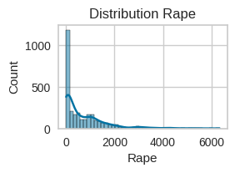
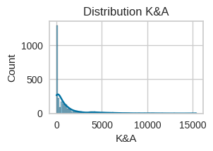
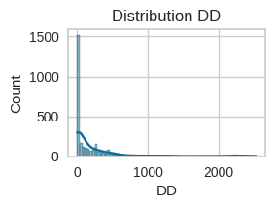
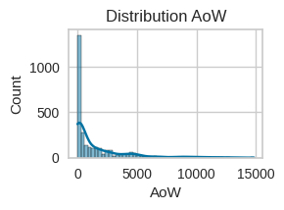
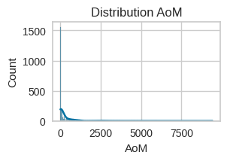
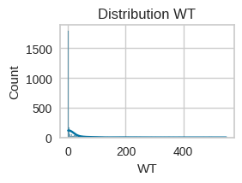
OUTPUTS
data distributions using histograms and boxplots, analyze correlations via a heatmap.

Slide 14
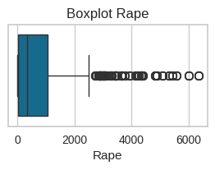
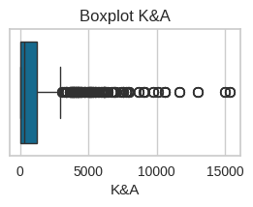
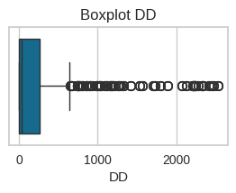
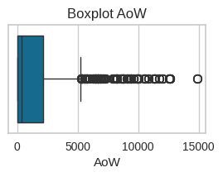
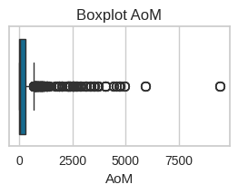
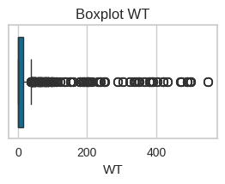
OUTPUTS

Slide 15
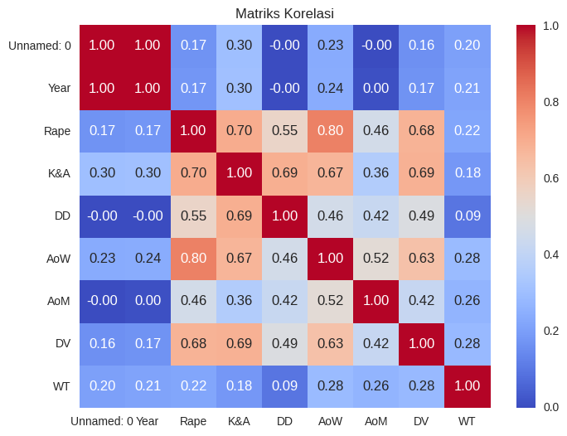
OUTPUTS

Slide 16
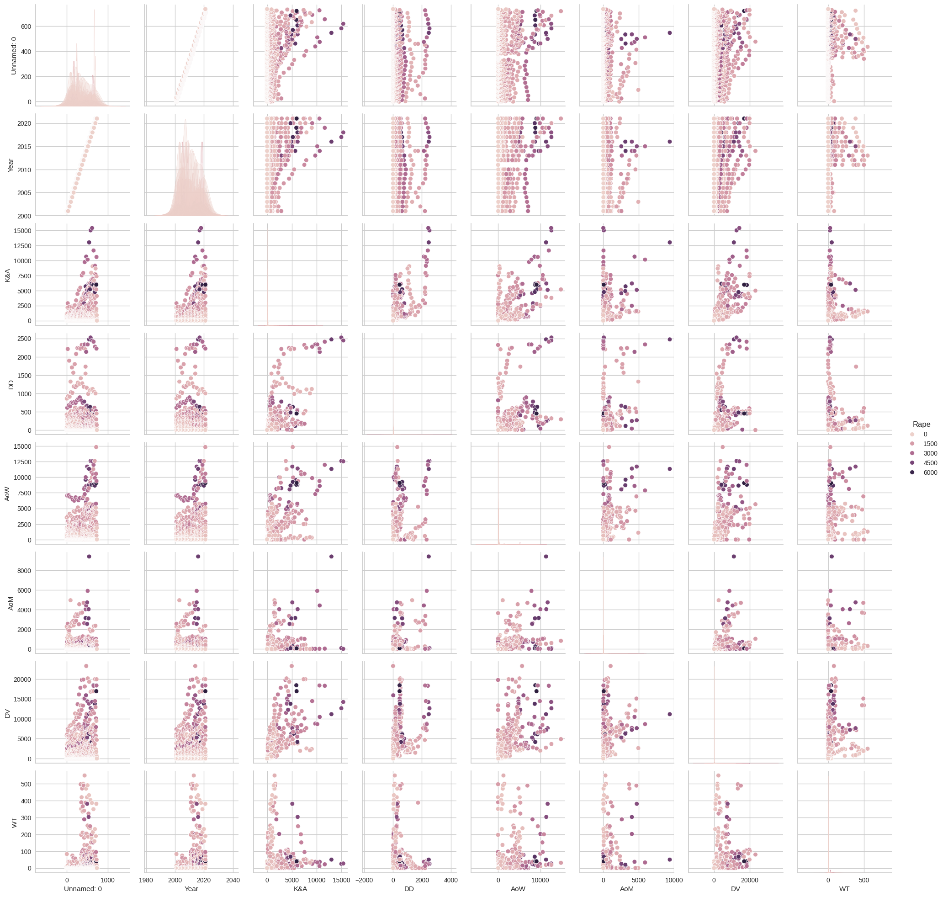
OUTPUTS
relationship between numerical variables

Slide 17
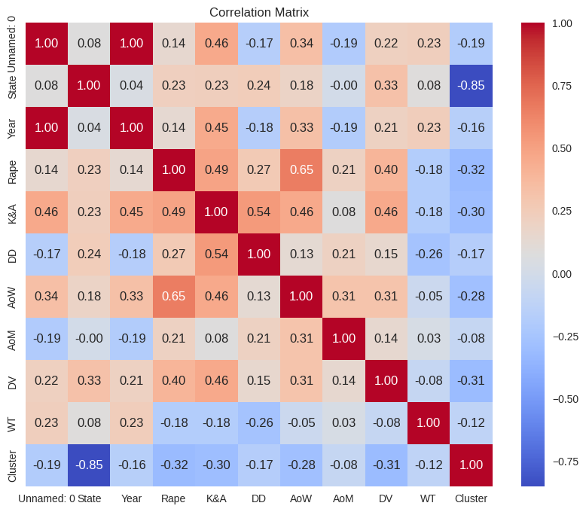
OUTPUTS
After feature engineering correlation matrix

Slide 18
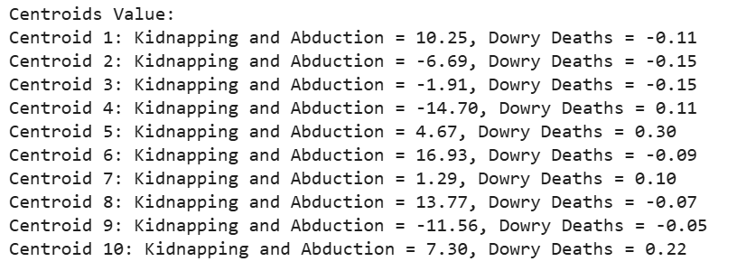
OUTPUTS
Itreation of centroids value

Slide 19
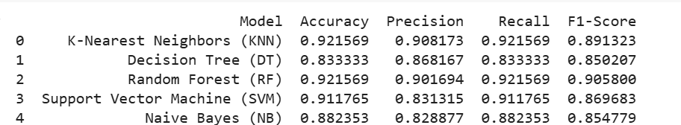
OUTPUTS
Different classification model Performance metrics

Slide 20
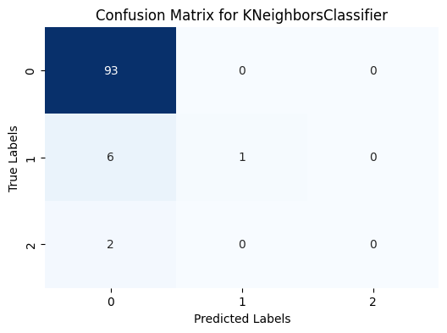
OUTPUTS
Graphical representation of true vs. predicted values for deeper insight into classification performance.

Slide 21
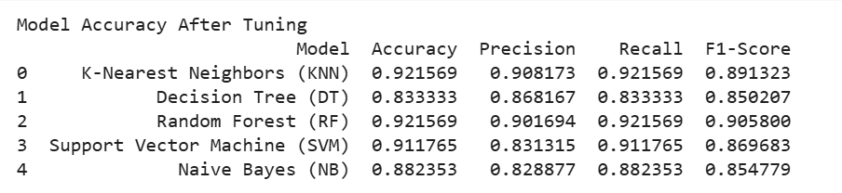
OUTPUTS
Model accuracy after tuning

Slide 22
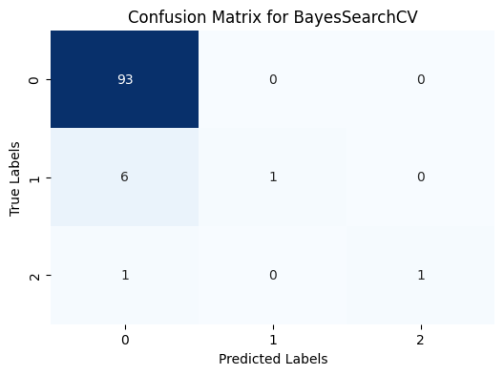
OUTPUTS
Evaluvation result

Slide 23

THANK YOU FOR YOUR ATTENTION!

